Slide 1


Slide 2
Fact: there is lots of sequence data out there
Question: how do you find a similar sequence to a mystery sequence you have?

Slide 3
Alignments are not expected to be perfect…
Align these two words…minimize letter mismatches
COELACANTH
PELICAN
COELACANTH
PELICAN

Slide 4
Global vs. Local alignment
FTFTALILLAVAV
FTALLLAAV
FTFTALILLAVAV
FT--AL-LL--AV
Global:
Maximize coverage across entire sequence (forced)
FTFTALILL-AVAV
--FTAL-LLAAV
Local:
Maximize continuous sequence, sacrifice length

Slide 5
BLAST = Basic Local Alignment Search Tool
NCBI = National Center for Biotechnology Information

Slide 6
There is oh so much to search through…where to start?
BLAST starts with a word (a seed)
Subject:
AGTCTAAAATGCTACATTTACGGGTCACCTAATCTAGG
Query:
TGCTATTTACGGTCAAC
First search for a “word”, e.g., TGC

Slide 7
There is oh so much to search through…where to start?
BLAST starts with a word (a seed)
Subject:
AGTCTAAAATGCTACATTTACGGGTCACCTAATCTAGG
TGC
Query:
TGCTATTTACGGTCAAC
Once seeded, can you add on?
Once mismatches occur, when do you stop (threshold)?
(for example 2 mismatches)

Slide 8
There is oh so much to search through…where to start?
BLAST starts with a word (a seed)
Subject:
AGTCTAAAATGCTACATTTACGGGTCACCTAATCTAGG
TGC
TGCTATT
Query:
TGCTATTTACGGTCAAC
5 matches, 2 mismatches (stop)
Total = 3 points
Each match is a positive point (+1)
Mismatches lose points (-1) or no points (0)
Can sequence be extended by adding gaps?

Slide 9
There is oh so much to search through…where to start?
BLAST starts with a word (a seed)
Subject:
AGTCTAAAATGCTACATTTACGGGTCACCTAATCTAGG
TGC
TGCTA--TTTACGG-TCAAC
Query:
TGCTATTTACGGTCAAC
17 Points (matches)
9 from gaps
= 8 points total score

Slide 10
BLAST outputs:
What are the units searched in a database?
What are “identities” – spaces with an exact match
What are “positives” – spaces with a functional match (BLOSUM matrix)
What is the “bit score” – an evaluation of how good the alignment is
What is “expected” – essentially, the probability that this match occurs by chance

Slide 11
BLAST process, reviewed:
Start with words (seeds)
Extend until below a threshold
Rank results based on scores
Give probability results for each
(# of matches)

Slide 12
The beauty of DNA…strikes again!
Databases and algorithms know DNA has two possibly coding strands!
Databases and algorithms “know” how to translate DNA to protein!
and vice versa…
So, you can BLAST:
DNA to DNA database
Protein to Protein database
DNA to Protein database
Protein to DNA database

Slide 13
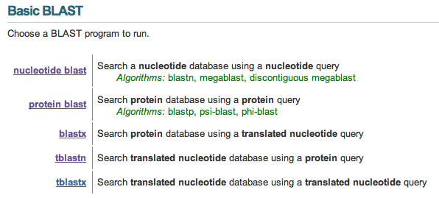
The type of search depends on the question and the sequence…

Slide 14
tblastn – search for protein in DNA database
What do you think the algorithm has to do?
blastx – search for DNA in a Protein database
What do you think the algorithm has to do?

Slide 15
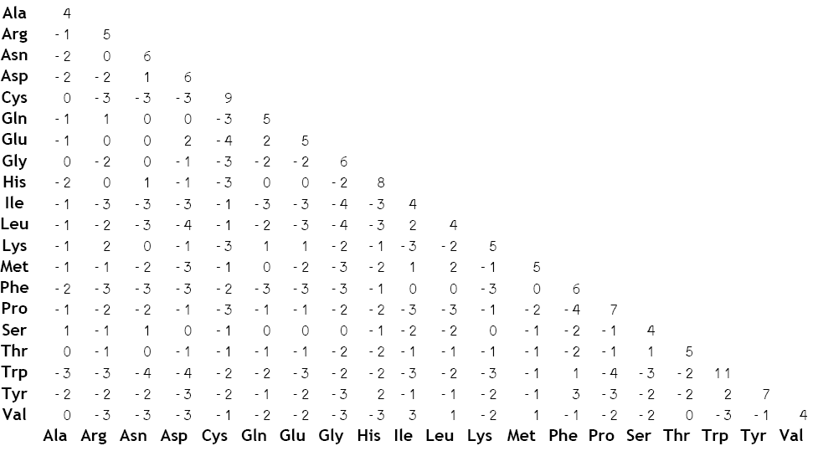
BLOSUM = blocks of amino acid substitution matrix
The likelihood of two amino acids (in different sequences) occurring with biological “sense” over
The likelihood of two amino acids occurring by chance (based on their frequencies).

Slide 16
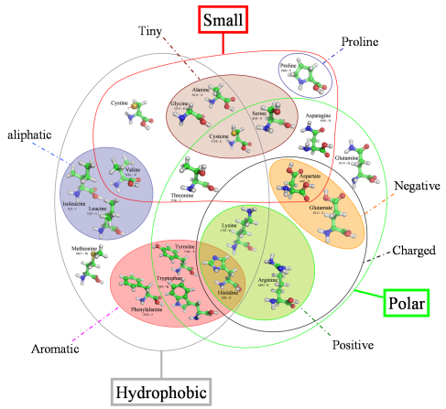

Slide 17
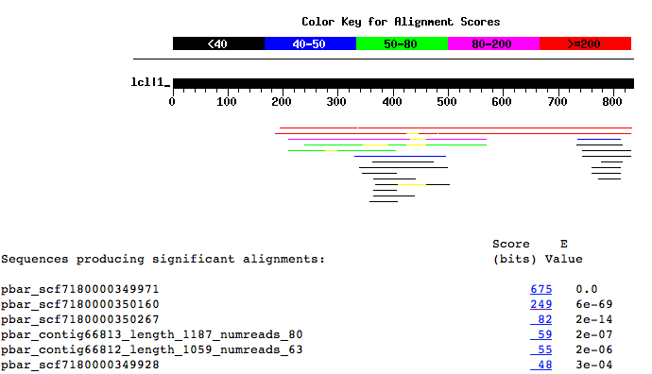

Slide 18
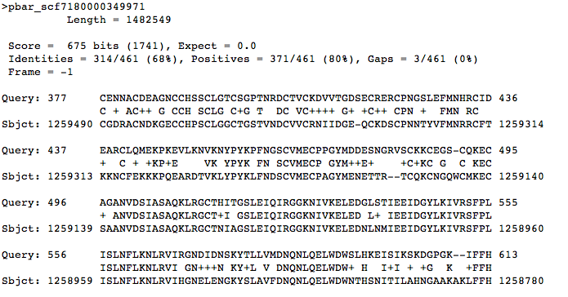
Looking for Insulin Receptor in the Harvester Ant
This gives me sufficient data to go and retrieve the DNA from the genome!
What about introns???

Slide 19
